Slide 1
MAGIC SQL to interrogate IBM DB2
Python

Slide 2
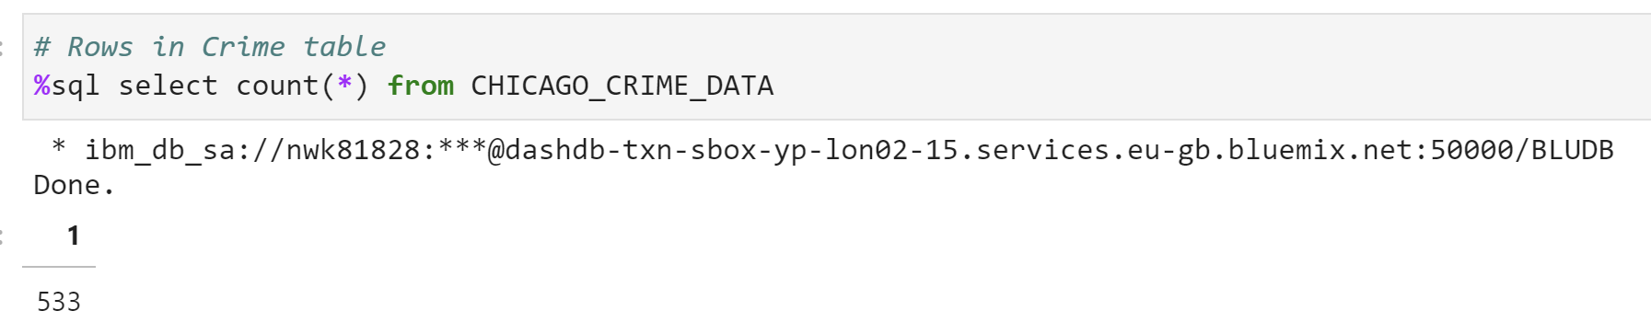
Count

Slide 3
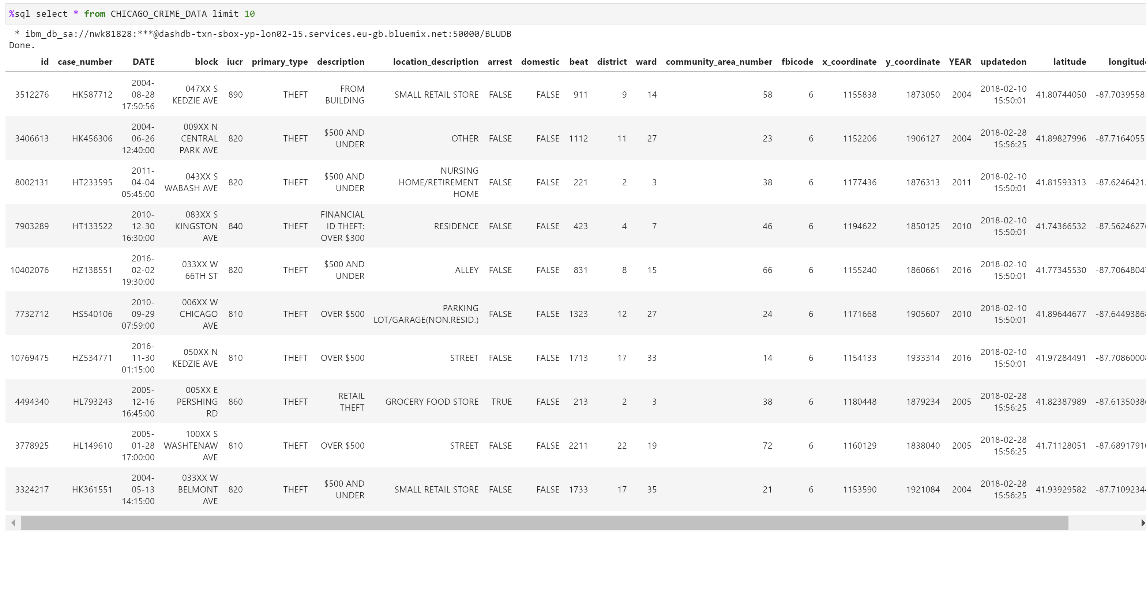
Head(10)

Slide 4
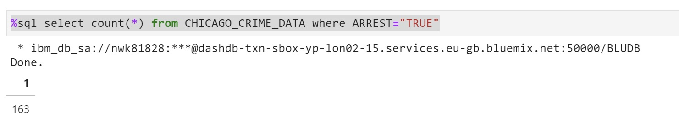
ALL Arrests

Slide 5
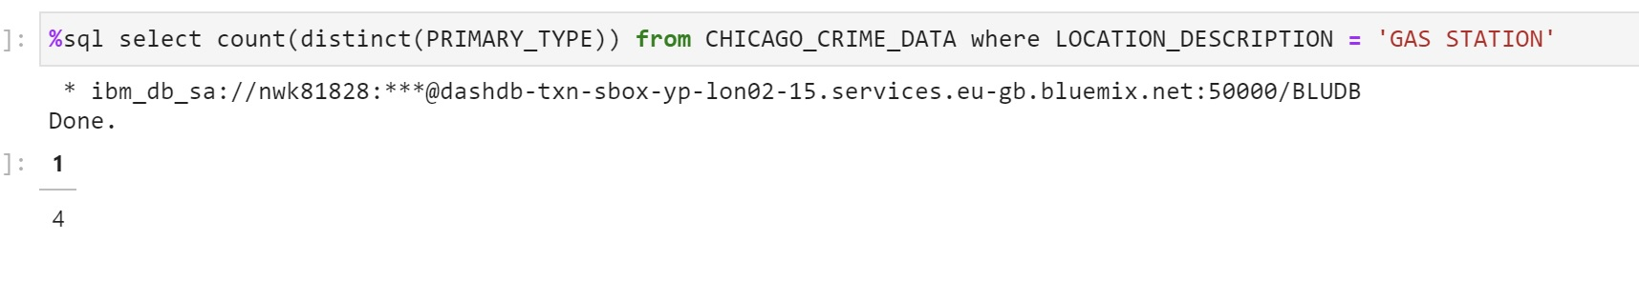
Number of Arrests in Gas Stations

Slide 6
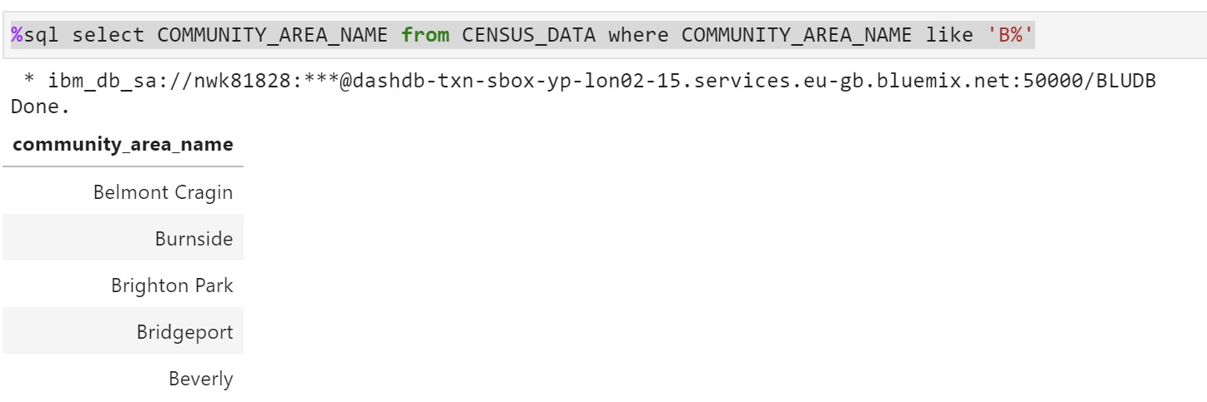
All Communities with ‘B’

Slide 7
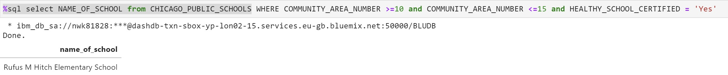
All Healthy_ School Certified with community area btwn. 10&15

Slide 8
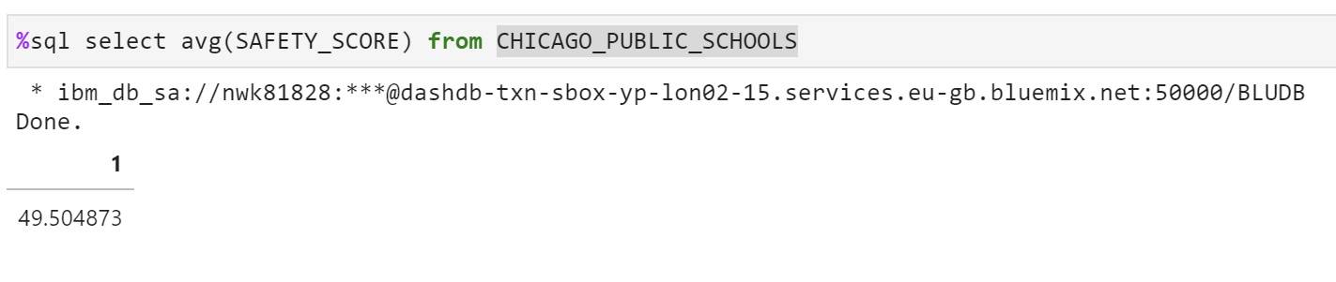
Average Safetyscore

Slide 9
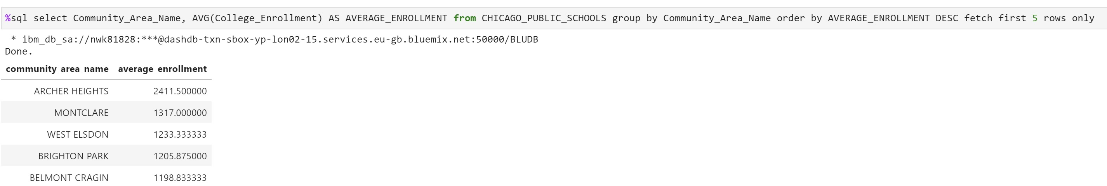
Best Chicago Schools by avg. Enrolment (top5)

Slide 10
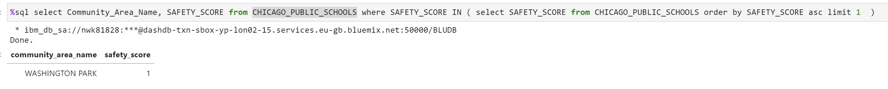
The Safest School in Chicago

Slide 11
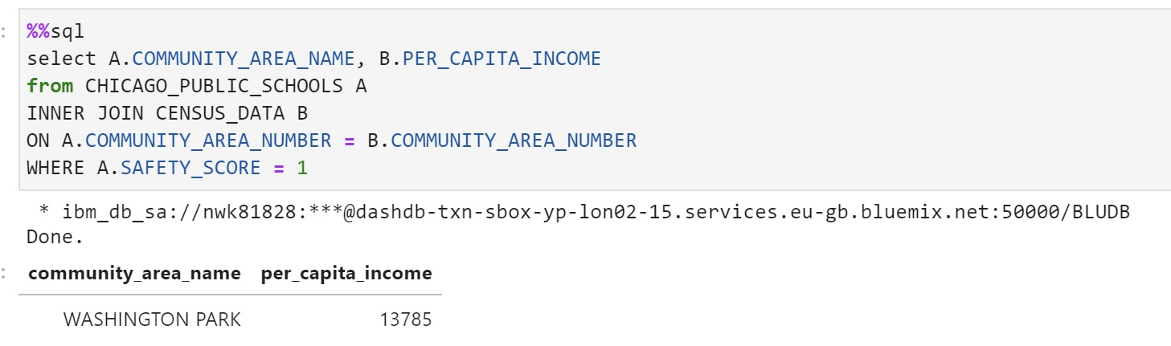
Per capita income of the safest school

